Slide 1


Sentiment Analysis using random forest Machine Learning Algorithm
Group Members : 01 Aishwarya Ahergawli
77 Ishwari Tale
27 Abhijeet Girase
44 Ayushi Khanbarad
Guided By : Prof. R. Y. Totare

Slide 2
Outline
Introduction
Motivation
Literature Survey
problem statement
Objectives
Scope
Hardware And Software Requirements
System Architecture
Data Flow Diagram
Conclusion
References

Slide 3
Abstract
Social Media sites like twitter have billions of people share their opinions day by day as tweets.
As tweet is characteristic short and basic way of human emotions. So in this paper we focused on sentiment analysis of Twitter data.
Most of Twitter's existing sentiment analysis solutions basically consider only the textual information of Twitter messages and strives to work well in the face of short and ambiguous Twitter messages.
Recent studies show that patterns of spreading feelings on Twitter have close relationships with the polarities of Twitter messages.

Slide 4
Abstract con..
In this paper we focus on how to combine the textual information of Twitter messages and sentiment dissemination models to get a better performance of sentiment analysis in Twitter data.
To this end, proposed system first analyzes the diffusion of feelings by studying a phenomenon called inversion of feelings and find some interesting properties of the reversal of feelings.
Therefore we consider the interrelations between the textual information of Twitter messages and the patterns of diffusion of feelings, and we propose an iterative algorithm called Convolution neural network (CNN) to predict the sentiment in Twitter messages.

Slide 5
Motivation
Text sentiment analysis is the process of analyzing, processing, summarizing and judging the sentiment tendency of subjective texts with sentimental colors.
It aims at mining the sentiment polarity in text information and has become a hot issue in the field of natural language processing (NLP) in recent years.

Slide 6
Literature Review
Sr No | Paper Details | Publication Year | Conclusion
1 | Short Text Sentiment Analysis Based on Multi-Channel CNN With Multi-Head Attention Mechanism | 2021 | This paper proposes a sentiment analysis model MCNN-MA that combines multi-channel convolutional neural network and multi-head attention mechanism. This model builds sentiment features, and combines sentiment features to form a three-channel input. Finally the sentiment classification result is obtained through the sentiment classification layer. The model in this paper is based on a multi-channel convolutional neural network, which has obvious advantages in training time compared to the model based on LSTM network
2 | A Study of the Application of Weight Distributing Method Combining Sentiment Dictionary and TF-IDF for Text Sentiment Analysis | 2022 | In this paper, a sentence vector generation method based on sentiment dictionaries and pre-trained word vectors is proposed for sentiment classification, which calculates the weights of sentiment words and neutral words in a sentence separately, and retains the overall information of the sentence while highlighting the sentiment words. From the experimental result, the accuracy of text sentiment analysis using the method proposed in this paper reaches 2.1%, which is 13.9% and 7.7% higher respectively than the other two methods.

Slide 7
Literature Review
3 | Sentiment Analysis of Customers’ Reviews Using a Hybrid Evolutionary SVM-Based Approach in an Imbalanced Data Distribution | 2022 | We produced four versions of the collected dataset using different tokenization methods, including 1-Gram, 2-Gram, 3-Gram, and bag-of-words. Further, we implemented a hybrid optimization technique comprising PSO and SVM to find the best weights while also finding the k values of four different oversampling techniques to predict the sentiments of reviews. The study demonstrates that the proposed PSO-SVM approach is effective and outperforms the other approaches in all investigated measures (accuracy, F-measure, g-means, and AUC). In more detail, the PSO-SVM provided better results than the standard SVM, LR, RF, DT, k-NN, and XGBoost in all versions of the datasets.
4 | RoBERTa-LSTM: A Hybrid Model for Sentiment Analysis With Transformer and Recurrent Neural Network | 2022 | This paper presents a hybrid model of Transformer and Recurrent Neural Network, referred to as the RoBERTa-LSTM model. Firstly, data augmentation with GloVe pre-trained word embedding is used to generate more lexically similar samples and to oversample the minority classes. The proposed RoBERTa-LSTM model benefits from the strengths of both RoBERTa and LSTM, where RoBERTa efficiently encodes the words into word embedding while LSTM excels in capturing the long-distance dependencies. The experimental results demonstrate that the proposed RoBERTa-LSTM model outshines the state-of-the-art methods in sentiment analysis on IMDb dataset, Twitter US Airline Sentiment dataset, and Sentiment140 dataset.

Slide 8
Problem Statement
To build and develop a sentiment analysis based on short textual information and diffusion patterns using random forest machine learning algorithms.

Slide 9
Objectives
To classify the sentiment polarity of a Twitter message as positive, neutral or negative.
To classify user sentiments using short text.
To test system using real streaming using Twitter API.
Try to improve accuracy using machine learning algorithm.
To help people in sentiments-related research to improve the processing of data

Slide 10
Scope
The ability to detect and track a user‘s state of mind has the potential to allow a computing system to offer relevant information when a user needs help not just when the user requests help.
Find sentiment polarities expressed in Twitter messages.
Find sentiments i.e. positive, negative and neutral.

Slide 11
Hardware And Software Requirements
Hardware Requirements:
Processor - Intel i3/i5/i7
Speed - 3.1 GHz
RAM - 4 GB(min)
Hard Disk - 40 GB

Slide 12
Hardware And Software Requirements
Software Requirements:
Operating System - Windows 7/8
Language - Java
Server side Script - Java Server Pages.
Database - My SQL 5.0
IDE - Eclipse Oxygen

Slide 13
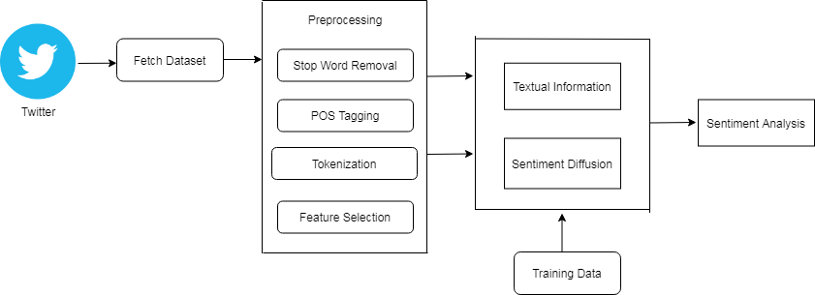
System Architecture

Slide 14
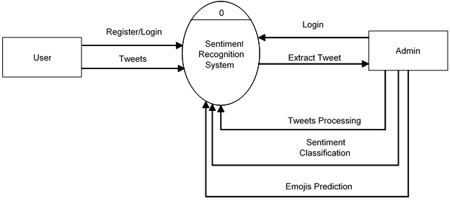
Data Flow Diagram

Slide 15
Conclusion
Polarity of mining sentiments expressed in Twitter messages is a significant and challenging task.
Most existing Twitter sentiment analysis solutions consider only the textual information of Twitter messages and cannot achieve satisfactory performance due to the unique characteristics of Twitter messages.
Although recent studies have shown that patterns of feeling diffusion are closely related to the polarities of Twitter messages, existing approaches are essentially based only on textual information from Twitter messages, but ignore the dissemination of information about feelings.
Inspired by the recent work on the fusion of knowledge of multiple domains, take a first step towards combining textual information and spreading feelings to get a better performance of Twitter's sentiment analysis.

Slide 16
References
Short Text Sentiment Analysis Based on Multi-Channel CNN With Multi-Head Attention Mechanism - Yue Feng And Yan Cheng – IEEE Volume 9 2021.
Sentiment Analysis of Customers’ Reviews Using a Hybrid Evolutionary SVM-Based Approach in an Imbalanced Data Distribution - Ruba Obiedat, Raneem Qaddoura, Ala’ M. Al-Zoubi, Laila Al-Qaisi, Osama Harfoushi, Mo’ath Alrefal, And Hossam Faris. – IEEE Volume 10, 2022
RoBERTa-LSTM: A Hybrid Model for Sentiment Analysis With Transformer and Recurrent Neural Network - Kian Long Tan, Chin Poo Lee , Kalaiarasi Sonai Muthu Anbananthen , And Kian Ming Lim – IEEE Volume 10, 2022
A Study of the Application of Weight Distributing Method Combining Sentiment Dictionary and TF-IDF for Text Sentiment Analysis - Hao Liu , Xi Chen , And Xiaoxiao Liu – IEEE Volume 10, 2022
A survey on concept-level sentiment analysis techniques of textual data - S Zad, M Heidari, JH Jones - 2021 - ieeexplore.ieee.org

Slide 17

Thank You

